Slide 1


NEXT GEN EMPLOYABILITY PROGRAM
CREATING A FUTURE-READY WORKFORCE
Student Name :
KETHAVATH TARUN NAIK
Student ID :
INTERNSHIP_173951615267aee8f889303
College Name :
STU67998b62a94131738115938
Sri Indu College of Engineering and Technology

Slide 2
CAPSTONE PROJECT SHOWCASE
Project Title
(P2) Online Auction Platform with React and ExpressJS Framework​
Abstract | Problem Statement | Project Overview | Proposed Solution | Technology Used | Modelling & Results | Conclusion | Q&A

Slide 3
Abstract
1
The Online Vehicle Auction Platform is a real-time web application where users can bid on cars, bikes, and trucks.
2
Built with the MERN stack and MySQL, it enables seamless live auctions with secure bidding.
3
Real-time bidding ensures transparency and competitiveness during auctions.
4
The platform ensures transparency, user-friendly interaction, and payment integration for smooth transactions.

Slide 4


Problem Statement
Traditional vehicle auctions are location-based and have limited participation.
Lack of transparency and bid tracking in manual auctions.
High cost and effort involved in organizing physical auctions.
Difficulty in verifying users and managing transactions securely.

Slide 5

Project Overview
Our project introduces an Online Vehicle Auction Platform that solves the limitations of offline vehicle auctions. It enables users to register as buyers or sellers, list vehicles with detailed information and images, and participate in live auctions. The platform offers a real-time bidding interface, allowing users to place bids and receive instant updates. Admins have the ability to manage users, monitor listings, and oversee all ongoing auctions. The goal is to make vehicle auctions more accessible, efficient, and trustworthy.

Slide 6
Proposed Solution
User-friendly interface for browsing, bidding, and listing vehicles.
Real-time communication using WebSockets for live bidding updates
Secure payment integration for transactions.
Authentication and role-based access control (RBAC) using JWT.
Bid history and transaction records stored in MySQL for traceability.

Slide 7
Technology used
Frontend: React.js
Backend: Node.js with Express.js
Database: MySQL (with Sequelize ORM)
Real-time Communication: Socket.IO (WebSockets)
Authentication: JWT
Tools: Postman, MySQL Workbench, VS Code

Slide 8
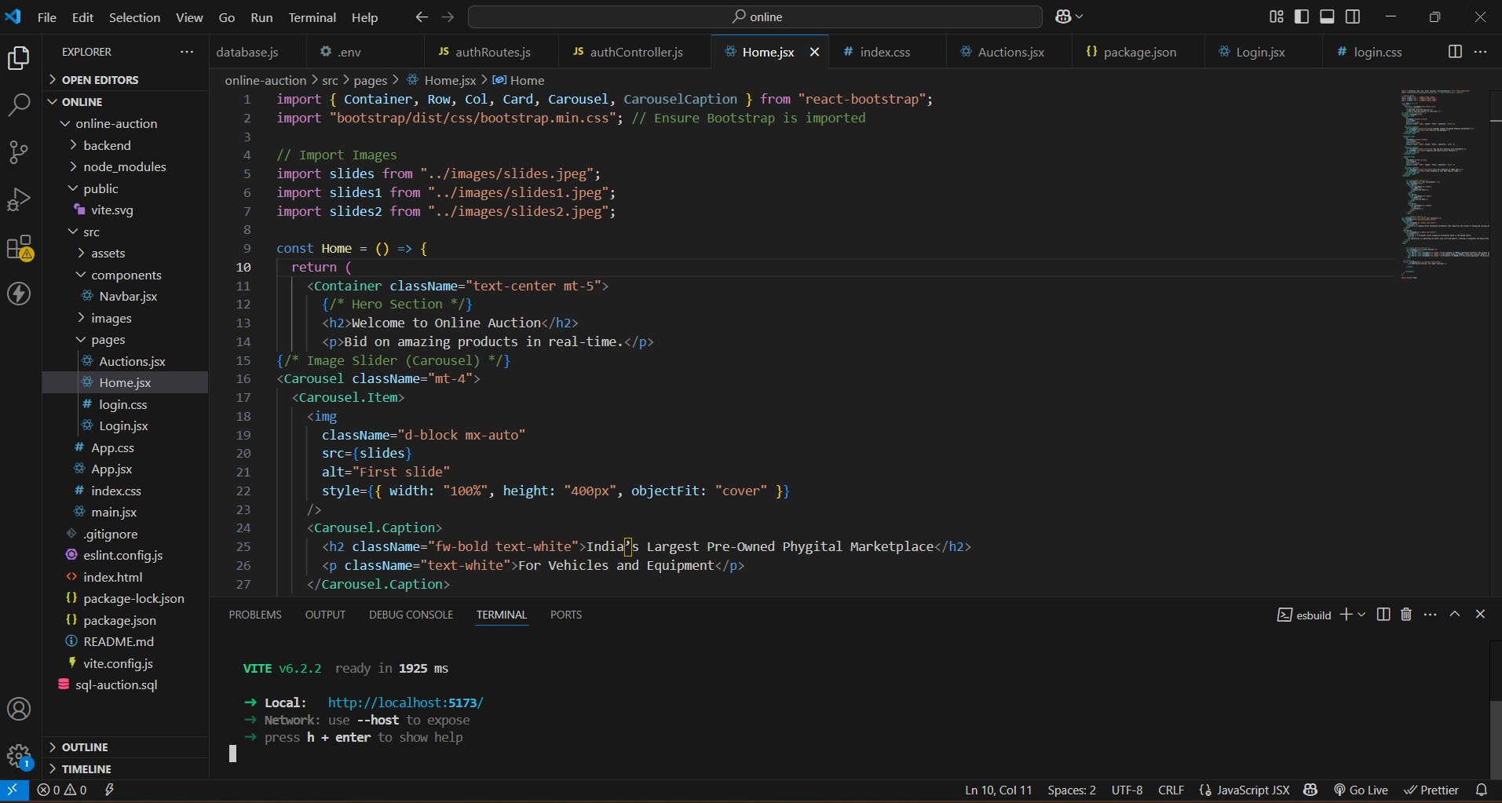
Modelling & Result

Slide 9
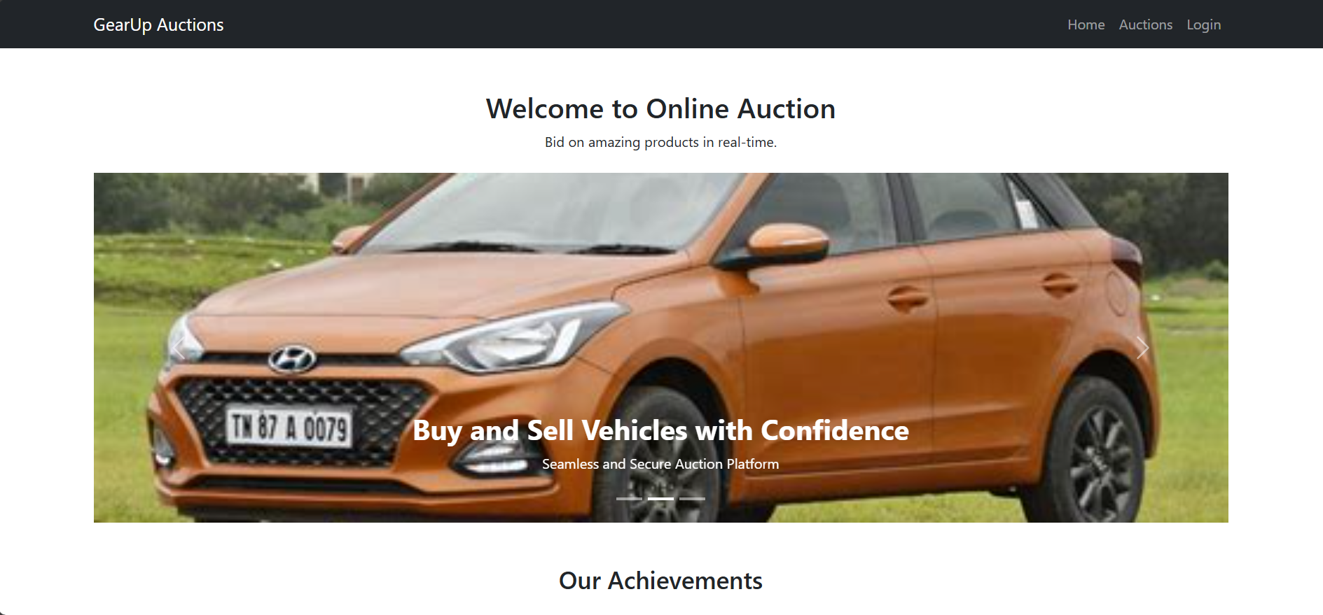
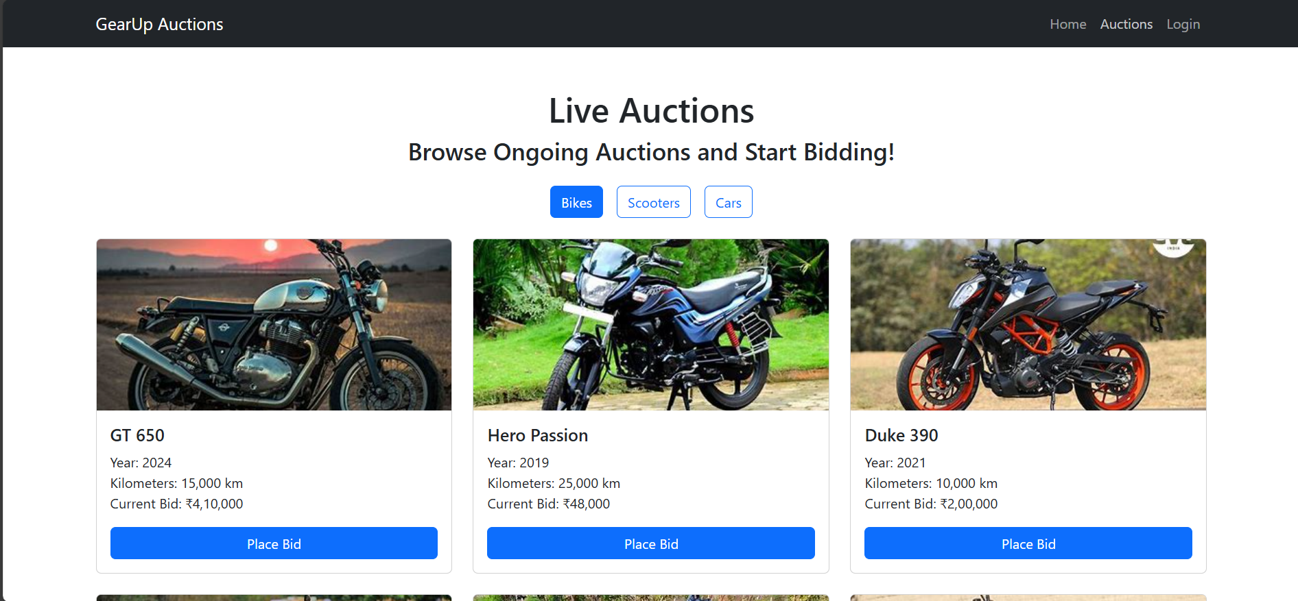
Modelling & Result

Slide 10
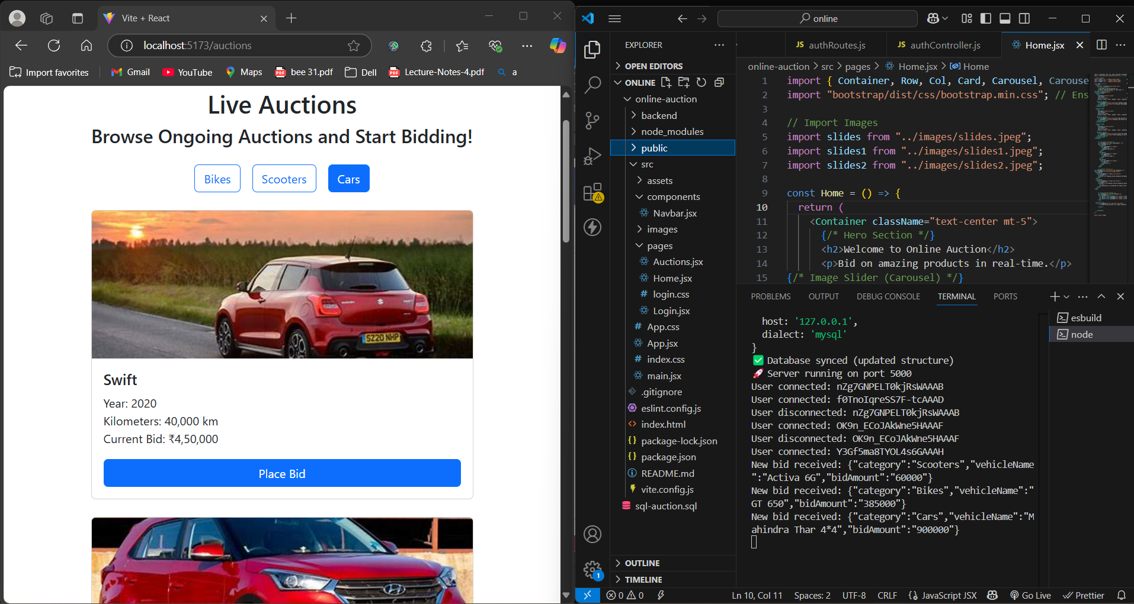
Modelling & Result

Slide 11

Conclusion
This platform bridges the gap between vehicle sellers and buyers through secure, real-time auctions.
It enhances accessibility, efficiency, and trust in online vehicle transactions
The integration of modern technologies ensures scalability and performance.
Future enhancements may include AI recommendations, chat support, and mobile app versions.

Slide 12


Notes:
Thank You !!

